Slide 1
Build a Serverless
Lead Capture on AWS
A full-stack serverless architecture using S3, Lambda, API Gateway,
DynamoDB, SES, CloudFront & Route 53
Static Hosting
Serverless
CDN
Email Notifications
Data Storage
Ahmed Tetteh
AWS Cloud Project

Slide 2
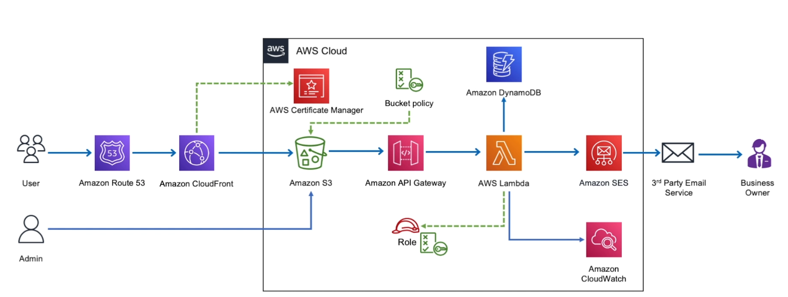
Project Overview
Project Goal
Build a serverless lead capture system for an eBook website. When a visitor clicks "Download Ebook", their contact details are captured, stored in DynamoDB, and an email notification is sent to the admin via SES — all without managing any servers.
Tech Stack
Scale
HTML, CSS, JavaScript
500 active users, 10–15 downloads/day
Global Performance
Data Storage
CloudFront CDN delivery
Contact details in DynamoDB
Email Notifications
Security
Project Architecture
HTTPS enforced on all requests
On every download via SES

Slide 3
AWS Services Used
Phase 1
Phase 1
Phase 1
Phase 1
Phase 2
Amazon S3
CloudFront
Route 53
ACM
API Gateway
Static website hosting + bucket policies
Global CDN for low-latency delivery
DNS management & custom domain
SSL/TLS certificate issuance
REST API endpoint trigger
Phase 2
Phase 2
Phase 3
All
All
AWS Lambda
Amazon SES
DynamoDB
IAM
CloudWatch
Serverless compute + email dispatch
Email notifications to admin
NoSQL storage for contact details
Roles, policies & permissions
Logging & monitoring
Phase 1
Phase 2
Phase 3
All Phases

Slide 4
Architecture Flow
User Browser
Route 53 +
CloudFront
API Gateway
AWS Lambda
HTML/CSS/JS
S3 + CloudFront
▶
▶
▶
Custom domain
HTTPS via ACM
REST endpoint
CORS enabled
Node.js handler
Business logic
Request Flow Summary
▼
Amazon SES
DynamoDB
1. User visits eBook site served from S3 via CloudFront
2. Route 53 routes domain → CloudFront distribution (HTTPS)
3. User fills form and clicks Download; JS triggers AJAX call
4. AJAX calls API Gateway endpoint (POST /contact)
5. API Gateway invokes Lambda function with form payload
6. Lambda sends email via SES + stores data in DynamoDB
7. CloudWatch logs all Lambda executions
Email to admin
Store contact
details
CloudWatch
IAM Roles
Logs & monitoring
Permissions &
policies

Slide 5
PHASE 1
Static Website Hosting
01
Create S3 Bucket
02
Upload Website Files
03
Request SSL Certificate (ACM)
Created an S3 bucket and configured it for static website hosting. Initially faced access restrictions — resolved by writing a bucket policy to allow public read access to objects.
Used the AWS CLI command `aws s3 sync . s3://bucketName` to upload all HTML, CSS, and JS files. Created a custom 404 error page for missing routes.
Requested a public certificate via AWS Certificate Manager for the custom domain. Validated it by creating a CNAME record in Route 53. Note: CloudFront only accepts certificates from us-east-1.
04
Configure CloudFront Distribution
05
Route 53 DNS Setup
Created a CloudFront distribution pointing to the S3 bucket. Attached the ACM certificate to enforce HTTPS. CloudFront caches content globally for low-latency delivery.
Created a Hosted Zone in Route 53 and added an A record (Alias) pointing the custom domain to the CloudFront distribution. Updated nameservers on the domain registrar.

Slide 6
Phase 1 — Challenges & Key Learnings
⚠ Challenge
✓ Resolution
Route 53 A record alias not pointing to S3
→
The S3 bucket name must exactly match the domain name for direct S3 hosting with Route 53 Alias records.
⚠ Challenge
✓ Resolution
Route 53 couldn't see the S3 bucket endpoint
→
Switched to using CloudFront as the origin instead of S3 directly — this also unlocks global caching.
⚠ Challenge
✓ Resolution
CloudFront couldn't find the ACM certificate
→
ACM certificates for CloudFront must be issued in us-east-1 (N. Virginia), regardless of where your resources are deployed.
⚠ Challenge
✓ Resolution
Mapping nameservers from AWS Hosted Zone
→
Copied the 4 NS records from Route 53 Hosted Zone and replaced the nameservers at the domain registrar.
Best Practice: Always use CloudFront in front of S3 — it decouples domain naming, adds HTTPS, and provides global caching.

Slide 7
PHASE 2
Serverless Backend — Contact Form
01
SES — Email Identity Verification
Lambda Handler (Node.js) - Sample Code
Created and verified two email identities in Amazon SES: one sender (noreply@domain.com) and one admin receiver. Required for sandbox mode.
const AWS = require('aws-sdk');
const ses = new AWS.SES();
exports.handler = async (event) => {
02
Lambda Function (Node.js)
const body = JSON.parse(event.body);
const { name, email } = body;
Wrote a Lambda function that receives form data, constructs an email payload, and calls SES.sendEmail(). Used test-driven events to validate the function before connecting API Gateway.
await ses.sendEmail({
Destination: {
ToAddresses: [ADMIN_EMAIL]
},
03
API Gateway — REST Endpoint
Message: { Subject: {...},
Body: { Text: { Data:
Created a REST API with a POST /contact route. Enabled CORS so the front-end JavaScript (hosted on S3/CloudFront) can make cross-origin requests.
`New lead: ${name} ${email}`
}}},
Source: SENDER_EMAIL
}).promise();
return { statusCode: 200 };
04
Connecting the Pieces
};
The website's JavaScript uses an AJAX call on form submit → hits API Gateway → triggers Lambda → Lambda calls SES. Verified end-to-end with real form submission.

Slide 8
PHASE 3
Data Management — DynamoDB Integration
Create DynamoDB Table
DynamoDB Schema
✓
Created a DynamoDB table to store lead capture data. Table includes fields for name, email, timestamp, and source.
email
String (PK)
Partition key
name
String
IAM Inline Policy for Lambda
✓
timestamp
String
ISO 8601
Added an inline policy to the Lambda execution role granting dynamodb:PutItem permission on the target table. Inline policy is preferred here — it's deleted automatically with the role.
source
String
eBook / campaign
Update Lambda Function
✓
Extended the Lambda handler to call DynamoDB.putItem() with the contact details in addition to sending the SES email.
IAM Inline Policy (Lambda Role)
{ "Effect": "Allow",
End-to-End Verification
"Action": "dynamodb:PutItem",
✓
"Resource": "arn:aws:dynamodb:
Submitted test forms and confirmed: (1) admin receives email via SES, (2) DynamoDB table is populated, (3) CloudWatch logs show both operations succeeded.
region:account:table/leads"
}

Slide 9
Results & Monitoring
3
9+
0
HTTPS
Phases Completed
AWS Services Used
Servers Managed
All Requests Secured
Hosting → Backend → Data
S3, CF, R53, ACM, GW, λ, SES, DB, CW
Fully serverless architecture
ACM + CloudFront enforcement
✅ Verified End-to-End Results
Static eBook website live at custom domain with HTTPS (CloudFront + Route 53 + ACM)
Contact form submits successfully — AJAX → API Gateway → Lambda — with 200 response
Admin receives email notification via SES for every download request
Contact details (name, email, timestamp) stored in DynamoDB after each submission
CloudWatch log streams confirm Lambda executions from both test events and API Gateway calls
S3 and CloudFront correctly handle GET requests; POST requests are handled by API Gateway only

Slide 10
Project Summary
This project demonstrates a production-grade serverless architecture on AWS. Starting from a plain HTML/CSS/JS eBook website, the solution progressively adds HTTPS delivery via CloudFront, serverless contact capture via Lambda + API Gateway, email notifications via SES, and persistent storage via DynamoDB — all without provisioning or managing any servers.
Infrastructure
Serverless
Data & Security
→ S3 Bucket Policies
→ Lambda (Node.js)
→ DynamoDB NoSQL
→ CloudFront CDN
→ API Gateway REST
→ IAM Roles & Policies
→ Route 53 DNS
→ CORS Configuration
→ CloudWatch Logs
→ ACM TLS Certs
→ SES Email
→ Inline Policies
Ahmed Tetteh · AWS Cloud Project · 2025

